Slide 1
Homework 2
- Wolfgang Karl Härdle
- Ying-Yu Chen
https://github.com/inyuCHEN/DEDA_2022_NYCU/tree/main/HW2_311707020_Inyu_Renew_Scatterplot%20and%20Maps%20of%20New%20Taipei%20City's%20bike%20dataset

Slide 2
Outlines
HW2：Scatterplot and Maps of New Taipei City’s bike dataset

Slide 3
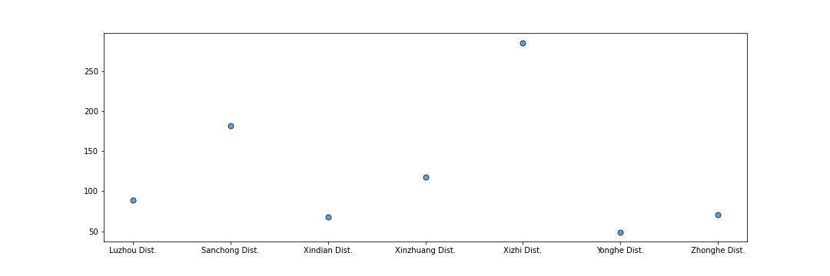
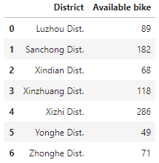
Results HW2
Scatterplot of New Taipei City’s bike dataset
location= [i['sareaen'] for i in json_tree]
availbike = np.array([int(i['tot'])for i in json_tree])-np.array([int(i['sbi'])for i in json_tree])

Slide 4
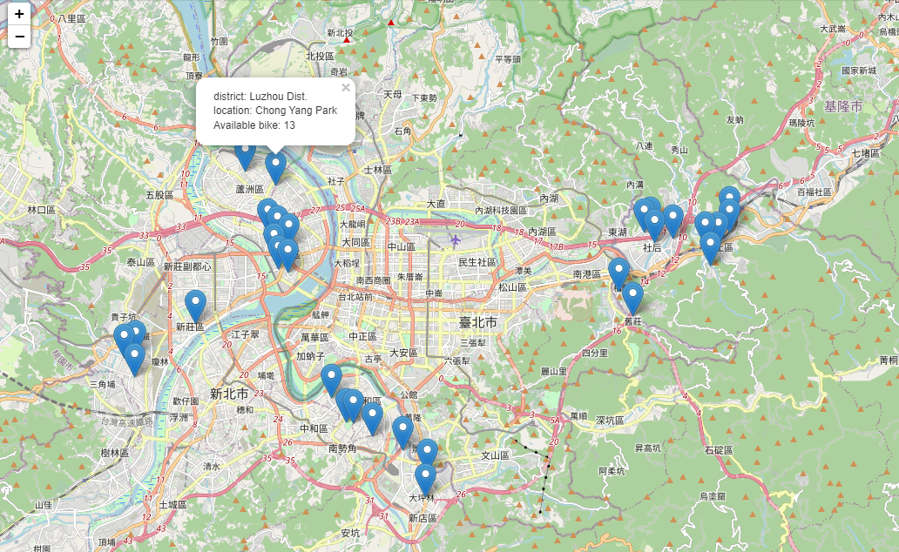
Results HW2
Maps of New Taipei City’s bike dataset
for index, row in dfs.iterrows():
information = 'district: '+ row['district'] + '<br>' + 'location: '+ row['location'] + '<br>'+ 'Available bike: '+ str(row['Available bike'])
folium.Marker(location=[row['lat'], row['lng']],
popup=folium.Popup(information, max_width=500), max_width='100'
).add_to(m)
m

Slide 5
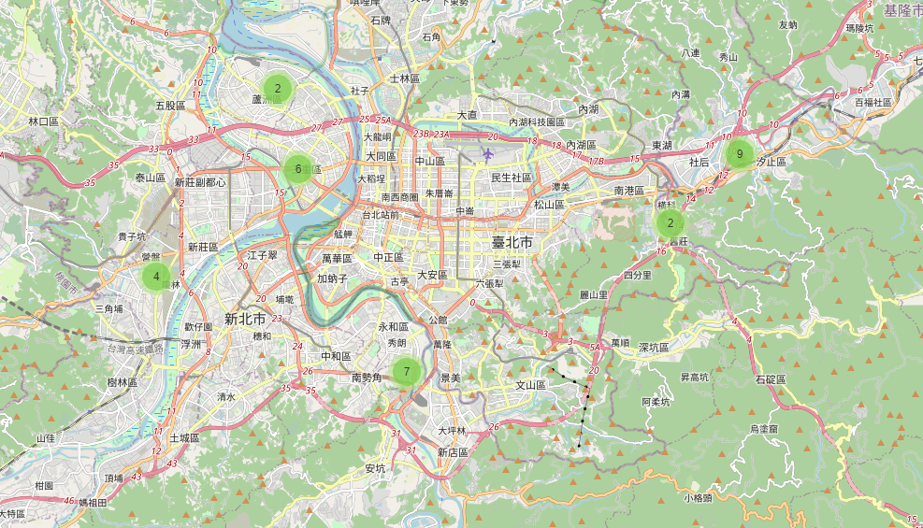
Results HW2
Maps of New Taipei City’s bike dataset
from folium.plugins import MarkerCluster
Eqk_map = folium.Map(location=[30, 15], zoom_start=2, tites='OpenStreetMap') marker_cluster = MarkerCluster().add_to(Eqk_map)
for index, row in dfs.iterrows():
information = 'district: '+ row['district'] + '<br>' + 'location: '+ row['location'] + '<br>'+ 'Available bike: '+ str(row['Available bike'])
folium.Marker(location=[row['lat'], row['lng']],
popup=folium.Popup(information, max_width=500), max_width='100').add_to(marker_cluster
Eqk_map

Slide 6
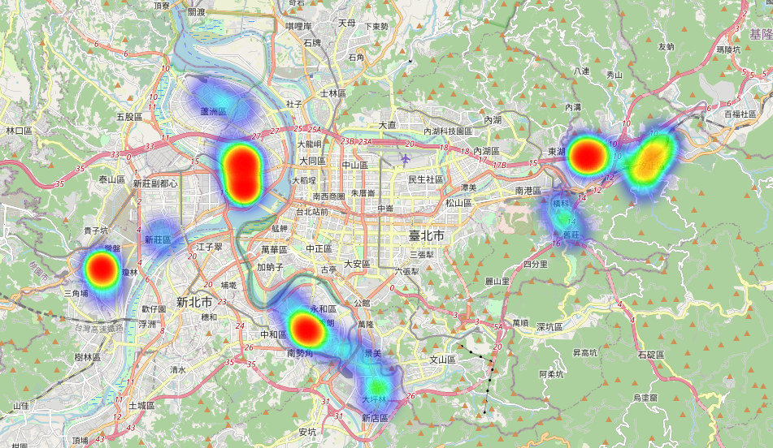
Results HW2
Maps of New Taipei City’s bike dataset
from folium.plugins import HeatMap
Eqk_Heatmap = folium.Map(location=[30, 15], zoom_start=2, tites='OpenStreetMap')
Heat_data = [[row['lat'], row['lng']] for index, row in dfs.iterrowsHeatMap(Heat_data).add_to(Eqk_Heatmap)
Eqk_Heatmap

